Slide 1
Computer Implemented Inventions

Slide 2
"A method of promoting toy sales,
comprising the step of
placing the toys on the lower shelves of the store, where they are easily accessible for children."
2

Slide 3
IP for Software?
"Software patent"
is a colloquial expression
may mislead to the assumption that source/ object code is patentable
"Computer-implemented invention" - CII
an invention whose implementation involves the use of a computer, computer network or other programmable apparatus
with features realised wholly or partly by means of a computer program
Examples:
a program-controlled ...
washing machine cycle;
car braking system.

Slide 4

What is an Invention?
Patentable Inventions
European patents shall be granted for
any inventions, in all fields of technology,
provided that they
are new
involve an inventive step and
are susceptible of industrial application
→ A.54
→ A.56
→ A.57
There is no positive definition of the term "invention"

Slide 5


European Patent Convention
What is NOT an Invention?
A.52(2)
The following, in particular,
shall not be regarded as inventions:
discoveries, scientific theories, mathematical methods;
aesthetic creations;
schemes, rules and methods for performing mental acts, playing games or doing business, and programs for computers;
presentations of information;
A.52(3)
...only to the extent to which a patent application relates to such subject matter or activities as such.

Slide 6
What is an Invention?
Non-Inventions
Narrow Interpretation
Activities falling within the notion of a non-invention would typically represent purely abstract concepts devoid of any technical implication.
A non-invention has no technical character.
T 258/03 (HITACHI)

Slide 7

Technical Character
Further requirement for patentability
implicitly contained in the law:
the invention must be of "technical character"
to the extent that it
must relate to a technical field
must concern a technical problem
must have technical features in terms of which the matter for which
protection is sought can be defined in the claim
- no general definition of „technical“

Slide 8



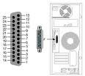

Technical is...
processing physical data parameters or control values of an industrial process
processing which affects the way a computer operates
saving memory, increasing speed
security of a process, rate of data transfer etc.
the physical features of an entity
memory, port etc.

Slide 9
Computer Programs
...for computer programs and computer program products...
The computer program, when carried out has to provide a "further technical effect“
The normal technical effects like flow of electrical current are not sufficient.
T1173/97 - IBM T0935/97 - IBM

Slide 10


Computer Programs
further technical effect
control of a brake in a car
faster communication between mobile phones
secure data transmission (encryption of data)
resource allocation in an operating system
no further technical effect
aesthetical effects of music or a video
new rules for an auction scheme
selling and booking sailing cruise packages
calculation of a pension contributions

Slide 11

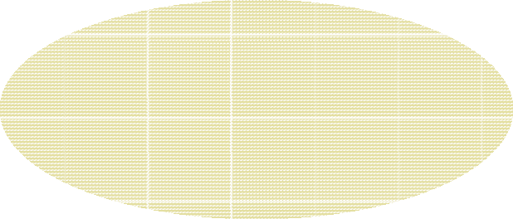

Exclusion
Subject-matter is not excluded from patentability
× Subject-matter is excluded from patentability
obvious ?
Closest prior art
Subject-matter
Technical character No technical character
not relevant for inventive step
At least one feature has technical character => subject-matter has technical character.
17

Slide 12
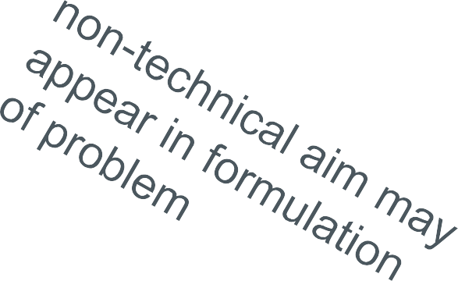
Inventive step
Problem and solution approach
Establish closest prior art
Determine differentiating features and their technical effects
Formulate an objective technical problem
Decide whether the proposed solution is obvious for the skilled person

Slide 13






2. Examples:
Computer implemented method for doing business
19

Slide 14








Example from Business Methods
"A method of controlling payment and delivery of content"
user
content provider
Regulation: access to content is free
if user is from a country with GDP < limit value AND
if the requested content is scientific content

Slide 15

Example I:
A method of controlling payment and delivery of content, the method comprising:
a provider receiving a request for content from a user;
the provider accessing content information describing the requested content;
the provider accessing regulation information describing at least one regulation that is related to the payment and the content information of the requested content and to geographical information of the user;
determining the geographic location of the user;
the provider determining whether the requested content satisfies the at least one regulation;
if so, delivering the requested content to the user for free;
if not, transmitting a payment request to the user.
Clearly Technical Aspects
none
Non-tecchnical process/ aspects

Slide 16
Example I:
The subject matter of the claim defines purely a business or administrative method and does not have a technical character.

Slide 17

Technical: yes – but: inventive?
Example:
A computer implemented method of controlling payment where some details are technical
= +
business method
Does this merit
a patent?
technical difference: inventive?
-> NO
technical character: yes
technical character: no

Slide 18
Example II:
A computer-implemented method of controlling payment and delivery of content within a computer system comprising a user terminal, a provider server and a database which are connected via a communication network, the method comprising:
the provider server receiving a request for content from the user terminal;
the provider server accessing in the database content information describing the requested content;
the provider server accessing regulation information in the database describing at least one regulation that is related to the payment and the content information of the requested content and to geographical information of the user;
determining the geographic location of the user;
the provider server determining whether the requested content satisfies the at least one regulation;
if so, delivering the requested content to the user terminal
if not, transmitting a payment request to the user terminal.

Slide 19

Example II:
Clearly Technical Aspects
A computer implemented method comprising:
a server receiving data from a terminal over a communication network;
the server accessing data in a database;
the server processing the accessed and received data;
the server transmitting the processing result to the terminal;
Non-Technical Aspects/ Process
Same business process as in Example I
no technical interaction
does not contribute to technical character
The subject matter of the claim defines technical and non- technical aspects and thus has technical character.
assessment of inventive step

Slide 20
Example II: Inventive Step
Technical character: Non-technical aspects:
Requirements specification:
yes yes
= business method:
"ordering content and calculating its price"
Closest prior art:
computer system comprising a server, database, and a terminal which are connected via a communication network
said business method
none, no technical implication of non-technical aspects data processing expert
non-technical differences: technical differences: Skilled person:
Objective technical problem:
no technical problem OR
automate said business method on said computer system
implementation/ automation is considered obvious
Solution:

Slide 21
Example III:
A computer-implemented method of controlling payment and delivery of content within a computer system comprising a user terminal, a provider server and a database which are connected via a communication network, the method comprising:
the provider server receiving a request for content from the user
terminal;
the provider server accessing in the database content information describing the requested content;
the provider server accessing regulation information in the database describing at least one regulation that is related to the payment and the content information of the requested content and to geographical information of the user;
determining the geographic location of the user;
the provider server determining whether the requested content satisfies the at least one regulation;
if so, delivering the requested content to the user terminal
if not, transmitting a payment request to the user terminal.
wherein the geographic location of the user is determined by the IP address of the user terminal using method steps x, y, z.

Slide 22
Example III: Inventive Step
Technical character: Non-technical aspects:
Requirements specification:
yes yes
= business method:
"ordering content and calculating its price"
Closest prior art:
computer system comprising a server, database, and a terminal which are connected via a communications network capable of determining the location of user.
said business method method steps x, y, z data processing expert
non-technical differences: technical differences: Skilled person:
Objective technical problem:
automate said business method
find alternative method for determining geographic location of use
automation is obvious
obvious?
Solution:

